Slide 1


Price Model
Presented by :
Maarten Van den Bulcke
Leonor Drummond
Hoang Minh Nguyen
Jacques Declercq

Slide 2
Table of Content
Immo-Eliza - Price Model
Goal & Project Summary
Data Analysis
Data Cleaning
Data Interpretations
Data Visualizations
Conclusion

Slide 3






Goal : Create a machine learning model to predict prices on Belgium’s property sales.

Slide 4

Project Summary
+ 10k properties data Set.
Clean and organise the data.
Find variables influencing prices.
Interpret the data for market insights.
Visualise the data with graphics.

Slide 5
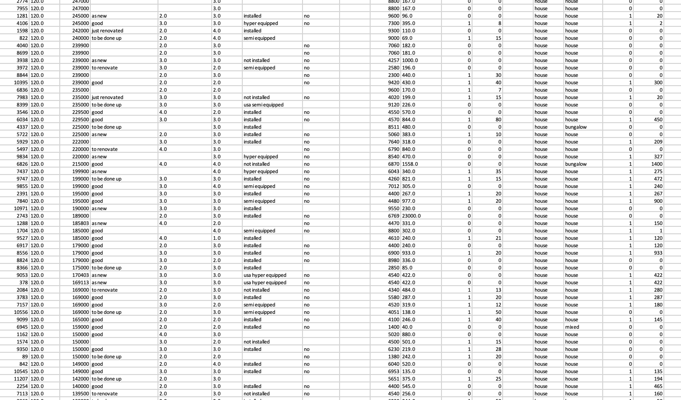
Data Analysis
GOAL :
Create a machine learning model to predict prices on Belgium’s property sales.
Clean the data : Remove rows with missing values and outliers* (ex. area & price)
Modify the data so its visualisable (ex. state of property open-fire)
Add to the data for better insights. (ex. region, province, cities)
*For the price model we based us on the largest sample in the dataset : properties worth < €750.000

Slide 6


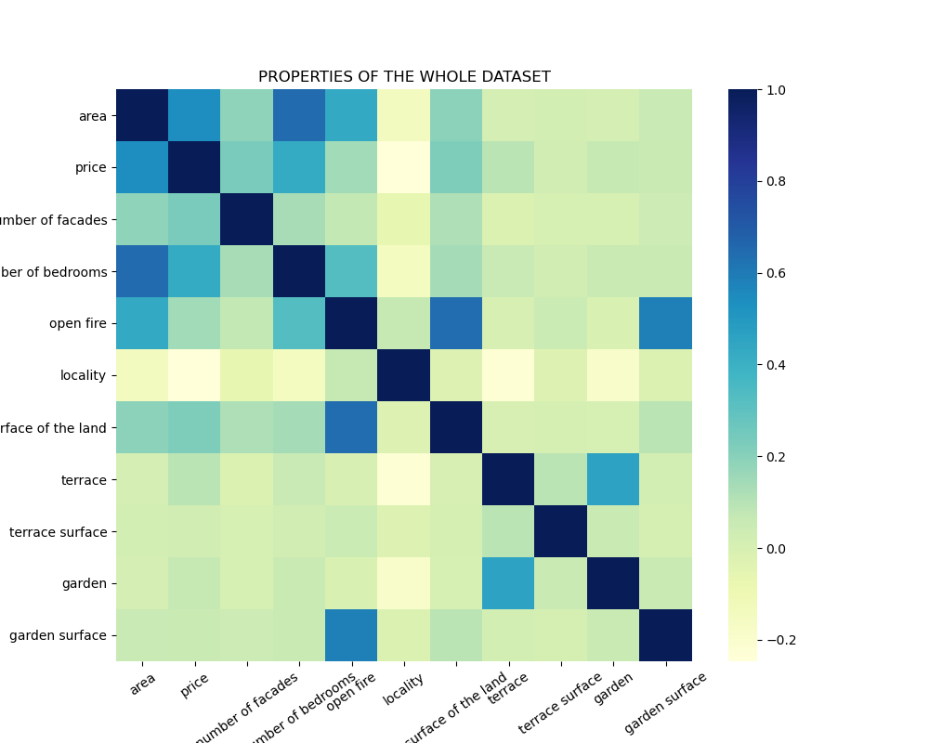
Price co-relations
Important numeric features : area (m2), number of bedrooms

Slide 7
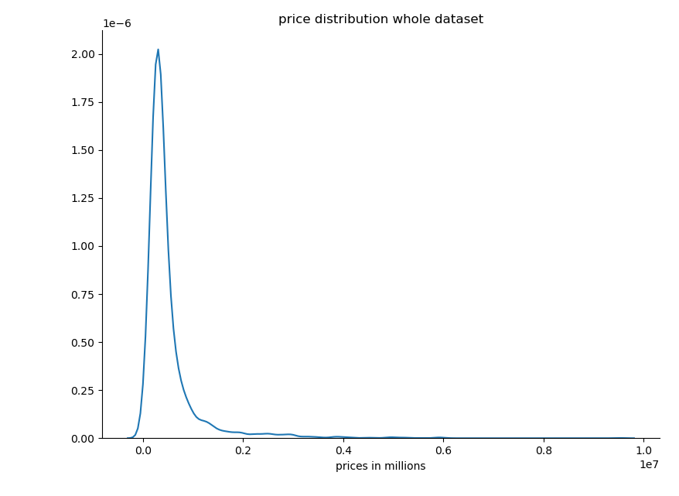
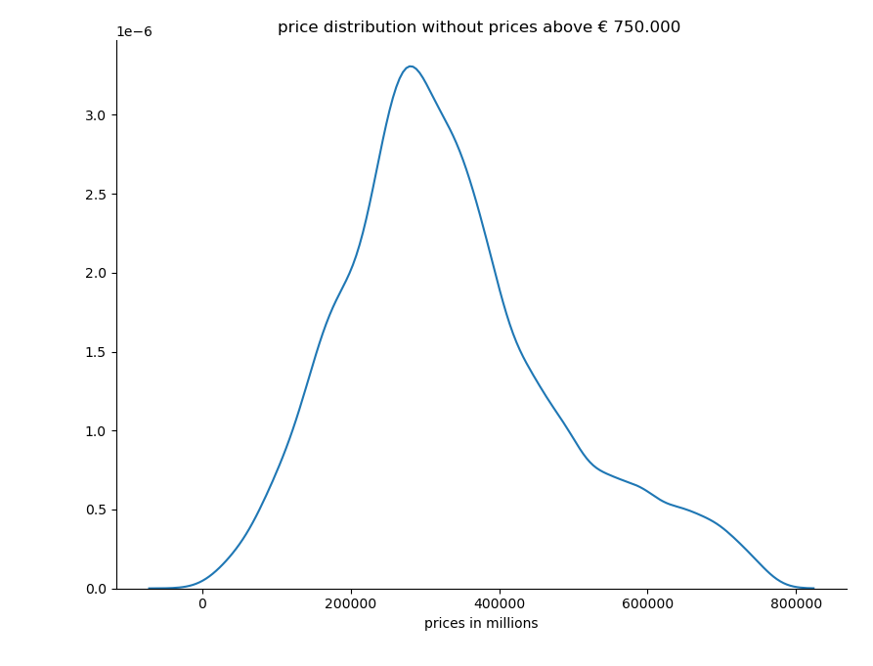
Price co-relations
Better for the ML price model (linear graph for supervised learning)

Slide 8
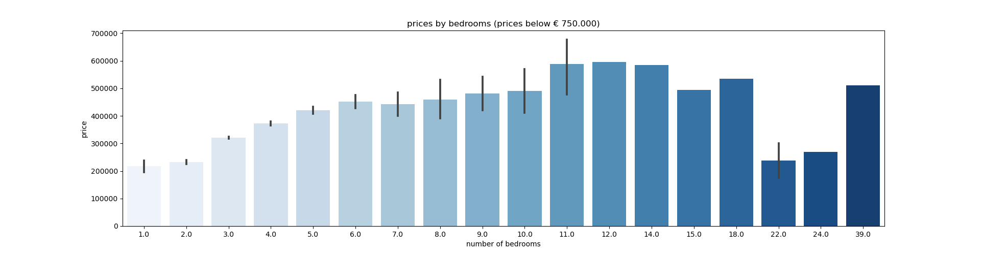


Price of property per nr of bedroom
Price.
Most expensive property has 11 bedrooms.
Interesting
At 11 bedrooms the price starts to stagnate.

Slide 9
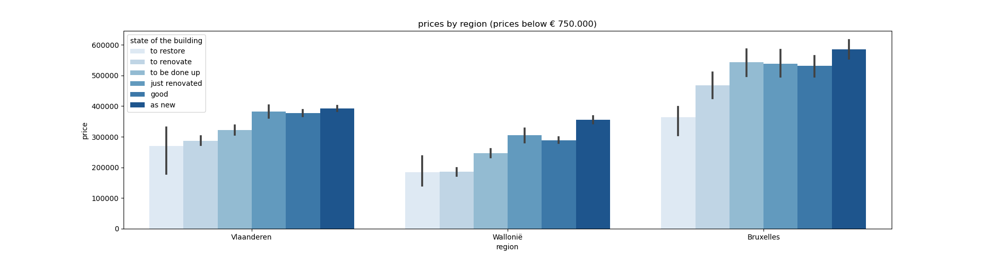

Price per region per state of property
Price.
Properties as new are the most expensive. Followed by just renovated.
Province
Brussels most expensive, Wallonia is the cheapest
Interesting
A to restore property in Brussels is as expensive as a new property in Wallonië

Slide 10
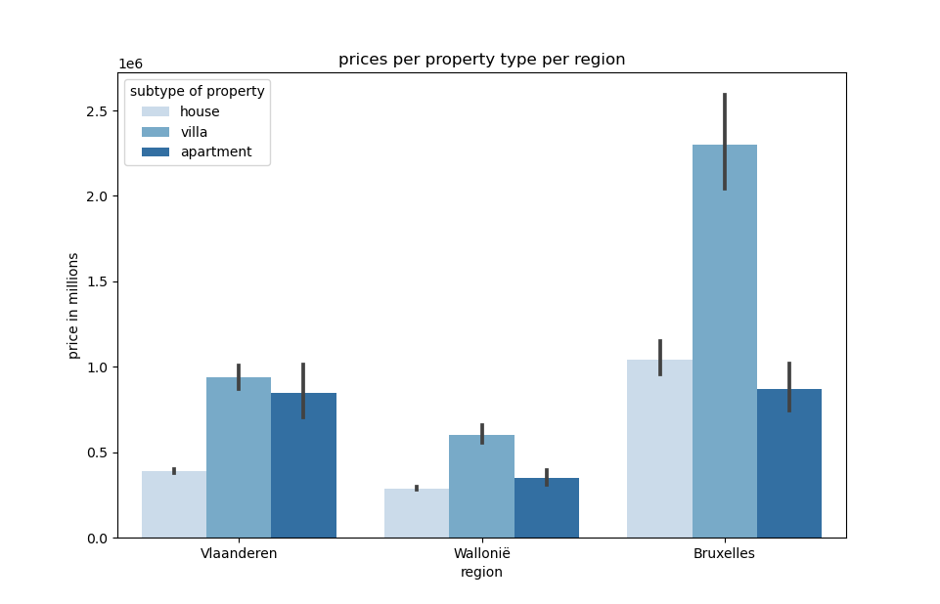
Price per subtype per region
Price
A Villa in Bruxelles is the most expensive property. 2nd to a house in the same region and followed by a villa in Vlaanderen.
Interesting
A villa is almost double the price of a house in any region.

Slide 11
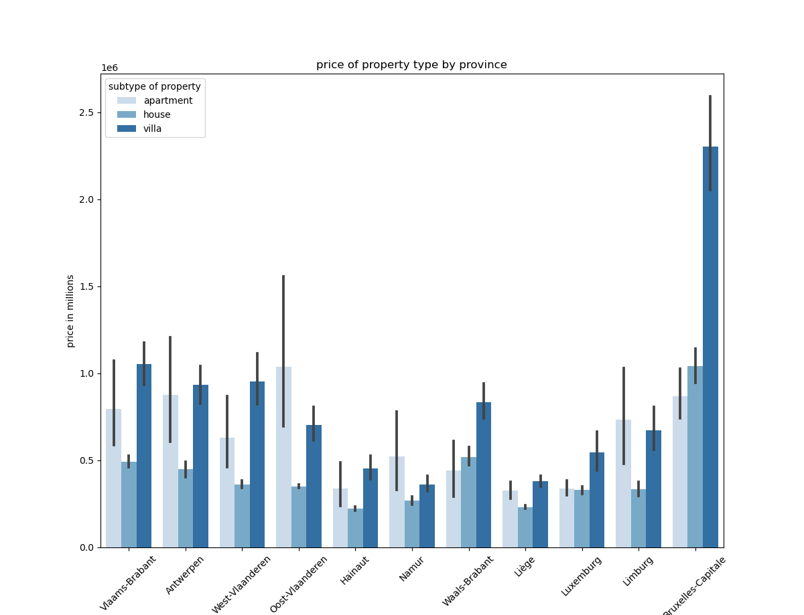
Price per subtype per province
Interesting
The most expensive apartment is in Oost-Vlaanderen.
The cheapest to buy is in Liege

Slide 12
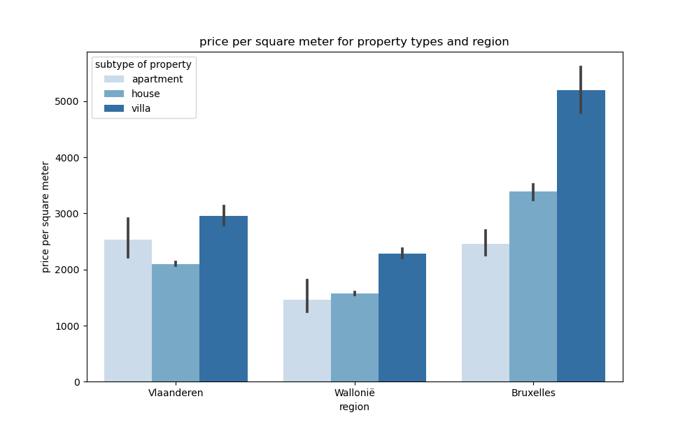
Price per m2
Price
Op een schaal van 1 (i.e. de groep met de meeste koopkracht) tot 8
(met de minste), zien we niet meteen grote verschillen in respons op deze content.
Interests
Volgende segmenten komen het sterkst naar boven bij de lezers van deze content: Movers, Immo Buyers, B2B & Interior
Province
Brussels most expensive, Wallonia is the cheapest

Slide 13
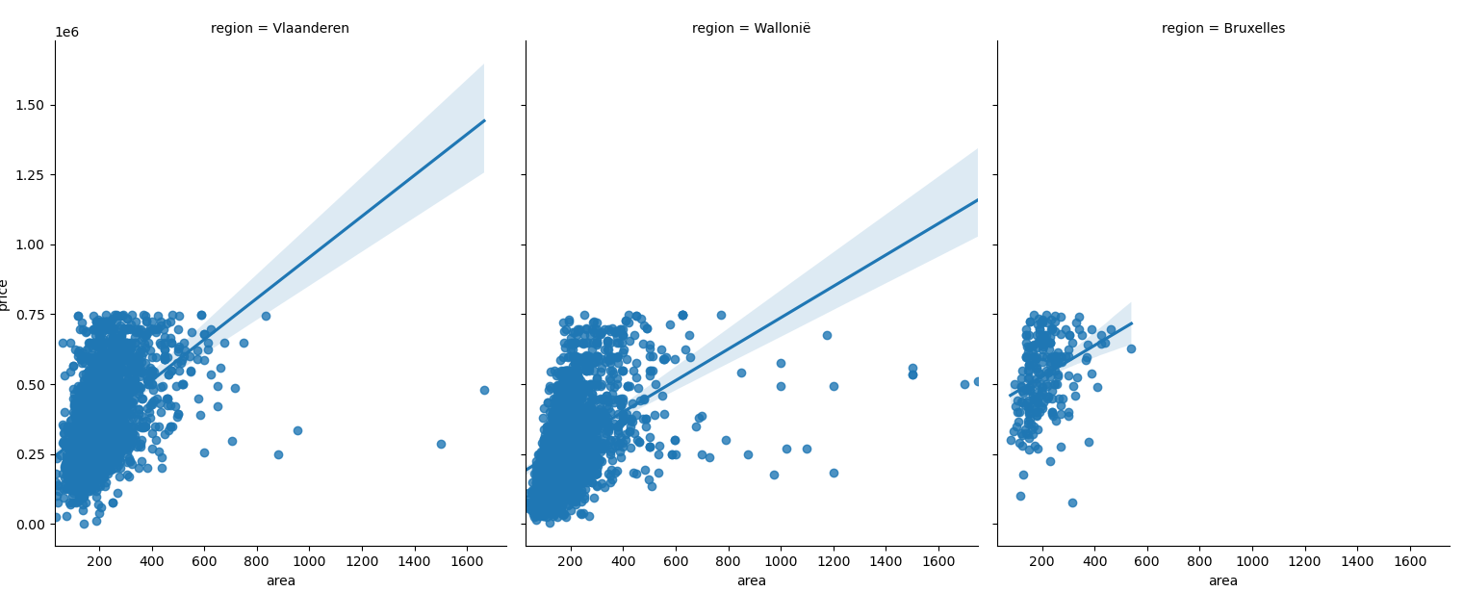
Price per area (m2) per region
Price
Op een schaal van 1 (i.e. de groep met de meeste koopkracht) tot 8
(met de minste), zien we niet meteen grote verschillen in respons op deze content.
Interesting
Wallonië properties have more m2
Province
Bruxelles starts at a higher price and has less outliers

Slide 14
Conclusions
Price, area, nr of bedrooms, state of the building and location is very price influencing.
Brussels is the most expensive region & Wallonië is the cheapest.
For the price model it would be more suitable to use price/m2 than area. (supervised learning)

Slide 15
THANK YOU

